Slide 1
Overview of Impacts from a
Neighborhood Lens and Suggestions
Shelter Better Task Force; August 23, 2021
Notes:
Goals - To add criteria for selection

Slide 2
Introduction
Within our Task Force Neighborhood Representatives, we represent an array of opinions and constituencies:
Katy Decker - Veterans Park Neighborhood Association President
Hillary Takahashi - Collister Neighborhood Association President
Tom Helmer - Sunset Neighborhood Association President
Annie McCutcheon- Veterans Park Neighborhood Leaders
Jennifer Godoi - Veterans Park Neighborhood Leaders
While we don’t all agree, we were able to speak respectfully together about difficult issues.
Not everyone agrees with everything in this presentation,
we are able to acknowledge diverse viewpoints.
It is important to note that the loudest voices do not speak for everyone.
Notes:
Katy, Veterans Park – proposed site w/in NA boundary; 98% against in January board meeting survey; more comprehensive outreach halted due to application pause (~6 supportive contacts 100+ survey negative, est. 200-400 total direct negative contacts. total population 2,140, perception of general opposition
Hillary, Collister – NA boundary ~750 ft from proposed site, extensive outreach for survey completion effort; ~350 against, ~40 for; total population 8,610. Perception of strong increase in both engagement and opposition with proximity to shelter
Tom, Sunset – NA boundary ~2,000 ft from the proposed site (in general, neighborhood is ½ mile to 1 mile away, has not conducted any formal outreach or surveys. 8 direct contacts from opponents, similar from supporters. Perception of general support within the neighborhood, population 3,017
Annie & Jennifer – each live within a few houses of the proposed State St location, and support the shelter

Slide 3
Agenda
During this presentation, we want to show the diverse viewpoints from a neighborhood where a shelter is being considered, what we understand from our time on this task force and make some suggestions for moving forward.
Overview of Impacts from a Neighborhood Lens and Suggestions
Neighborhood Representative Team – est. 10 minutes
Focus on Specific Neighborhoods
Veterans Park and Collister Neighborhood Associations – est. 25 minutes
Thoughts from the Sunset
Sunset Neighborhood Associations – est. 5 minutes
Question and Answer Period – est. 15 minutes
Notes:
Pass to Annie

Slide 4
Process Observations
POSITIVES
Task Force
Composition of members
Neighborhood Leaders
IFS participating
Communication within the task force
Information and specialty acquired
CONCERNS
Unclear Goals
IFS Communication
  Lack of transparency about buying the building
  Conditional Use Permit
Public feedback - emails, appropriate contact
IFS absolute position
Impact
Community Response
  What does compromise look like?
  Misinformation
Notes:
Annie

Slide 5
Neighborhood Opportunities (any site)
•See parts of society we don’t want to acknowledge
•Opportunity to give back
•Workforce Training, needed skills to help fill labor needs
•Help be part of a solution
•Potential to increase socio-economic diversity
“This is a unique opportunity in Boise for a neighborhood to come together to help make this shelter a success.” - Annie
Notes:
Tom - Boise KIND!!!

Slide 6
Neighborhood Concerns About Concerns about Impacts, Including Safety (any Site)
•Loitering/commandeering spaces with expectation of privacy
•Concentration of untreated alcohol/drug dependencies in public spaces
•Improper disposal of drug paraphernalia/human waste/litter
•Concentration of mental health struggles in public spaces
•Induced demand for shelter services/overflow
•Nighttime departures from shelter to neighborhood when behavioral expectations are not met
•Capacity evaluation for public services (Fire/EMS/Police/Library/Schools,etc.)
•Increased exposure to crime/violence (either against or by shelter guests)
•Increase in predatory business (drug dealing/payday loans/etc)
•Noise
•Parking
•Property Value
•Loss of/impact to businesses
•Concentration of poverty
Notes:
Tom

Slide 7
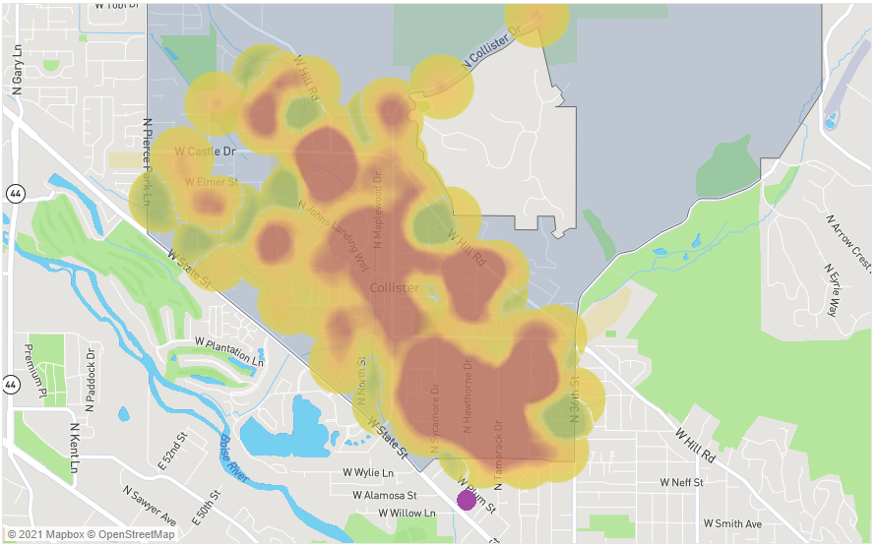
Neighborhood Response
Data suggests that the closer in proximity to the Site Location, the more potential opposition
This is apparent in Veterans Park, Collister and Sunset Neighborhoods
Considerations should be given to those in the immediate vicinity
Collister Election Results Map - Purple Dot proposed IFS Site
Notes:
Hillary -
Data might be skewed due to lack of uniform polling. There was as sense of urgency partially due to lack of clear Community Plan for IFS. We were trying to do the best without the best circumstances, we were initially told the end of Feb. was when the CUP permit was going to be submitted,
Seeking guidance on large, important poll

Slide 8
State Street Specific Considerations
•Interfaith has vetted this location and it meets many of the criteria they have identified as important for shelter
•Access to a bus line and bike transport via the Greenbelt
•Availability of typical services/amenities (bank, grocery store, parks)
•Potential concern was expressed that neighborhood residents would be hostile to shelter guests and/or staff
•Travel time to Terry Reilly/FMRI/VA, Courts, etc.
Notes:
Hillary
Although terry riley will have some type of presence on site
Pass to Katy

Slide 9
Recommendations
Example Community Considerations for Site Selection Process:
•Appropriate buffer to a residential area
•Concentrations of poverty and/or protected classes
•Public service capacity
*This is not a comprehensive list!
For any Site eventually selected, we would like to see, for example:
•A Community Engagement Plan (to be implemented prior to opening)
•Conditions of Approval
•Operating Plan, Security Plan
•Community Relations Plan (to be implemented following opening)
•CUP Enforcement Structure and Metrics of Measurement
*These should be submitted for public review and comment prior to revision and adoption
WE NEED an additional Task Force meeting(s) to better identify and evaluate community criteria
and their place in the scoring rubric
Notes:
Katy
Note - the feeling that we need more time to develop siting criteria and scoring rubric was unanimous

