Slide 1
Community Accessibility Survey Results
October 2020

Slide 2


OUR VISION
Creating a city for everyone

Slide 3

Mission
The City of Boise will create a city for everyone
by embracing our community in the decision-making process; innovating and investing to protect our environment; and ensuring a thriving local economy that benefits all.

Slide 4
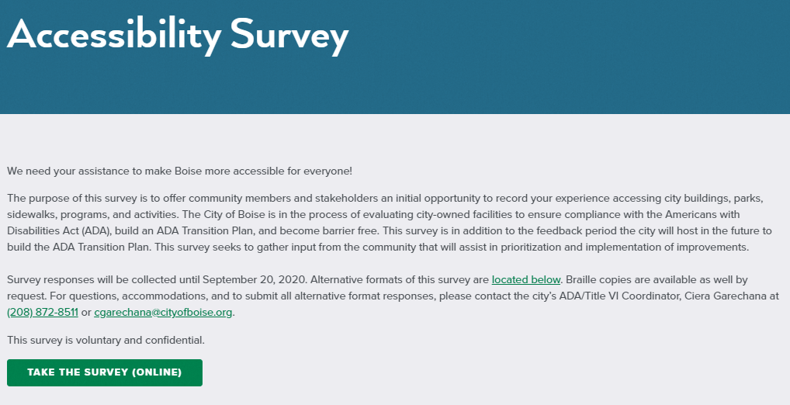
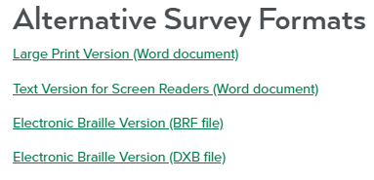
Accessibility survey conducted autumn 2020

Slide 5
Distribution of Survey
THE SURVEY WAS DISTRIBUTED THROUGH THE FOLLOWING
Commission for the Blind and Visually Impaired (I C B V I)
City of Boise’s Accessible Parking Committee (APC)
Northwest A D A Center - Idaho
Idaho Council for the Deaf and Hard of Hearing
Department of Health & Welfare
Idaho Fair Housing Council
Idaho Human Rights Commission
Idaho Council for Intellectual Disabilities
Center on Disabilities and Human Development
Idaho Vocational Rehab
Life – A Center for Independent Living
Internal City of Boise stakeholders
City of Boise’s AdVenture Program’s 1000+ person newsletter distribution list
Various A D A advocates and professionals in the community
Statewide Disability groups for visitors to Boise
“In the Know” City of Boise community newsletter

Slide 6
There were 99 total responses to the survey;
Each question, and responses to each question are included on following slides

Slide 7
Survey results

Slide 14
Of the many parks in Boise, do any of them have barriers or restrictions that make them unusable to you? Please list the park and describe the barrier.
I had the city add a sidewalk from the street to the camels back tennis courts a few years ago. Glad they did this for the wheelchair tennis players!
The handicap restrooms in ALL parks are inadequate.
DO NOT support the City making ALL parks physically accessible. I support making several parks accessible.
Unusable to those in wheelchairs, no friendly disabled playgrounds.
Manitou Park could use another sidewalk on the north end, along the fence for easier access to the field and dog area. It should be without an incline.

Slide 15
Of the many parks in Boise, do any of them have barriers or restrictions that make them unusable to you? Please list the park and describe the barrier. (continued)
Two City pools are not accessible (Lowell and South). It's time to make those two accessible. Please build new ones. Please start putting universal sex bathrooms at the pools so we can change individual with disabilities in a private area.
More and more un-leashed dogs are a real danger.
As a person without a physical disability, there is not a lot of play equipment for kids with disabilities in parks. It would be cool for that to be the case to encourage integration in early childhood. I also worry about whether some playgrounds with bark may prevent elderly family members from playing with young family members.

Slide 16
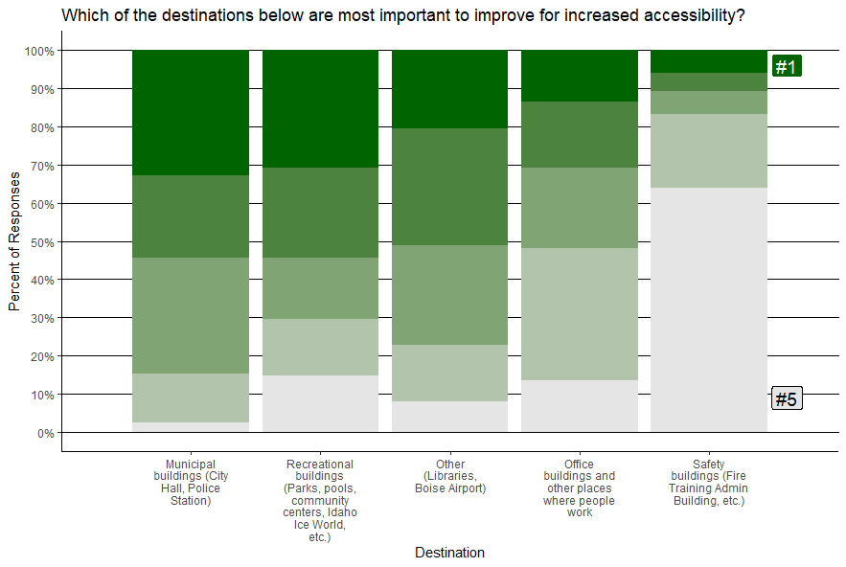
Rank 1 to 5 (1 as most important and 5 as least
important).

Slide 18
Have you encountered any obstacles to accessing any city-owned buildings or parks? If so, please describe the obstacle or obstacles below.
City hall is awful. There isn't good signage to where bathrooms are located. Parking is very poor in the area for accessible vans with ramps. The Capital Street entrance has no nearby parking. The south entrance is too steep and closes early (though closest to parking).
Communication and way-finding are usually a challenge.
The remodel of City Hall took away the handicap space at the front of the building which is the shortest distance to the main entrance. I can sometimes find one at the other side of the main entrance but then must make it the length of a block then a half a block before I reach the entrance. This may seem minor but for a person for which walking is difficult and painful, the fewer steps the better. I don't see how the current configuration is compliant. I understand the desire to create a bike path between the parking spaces and the sidewalk but at the expense of a handicap space near the entrance was not, in my opinion, good planning or planning with an understanding of the A D A requirements.

Slide 19
Have you encountered any obstacles to accessing any city-owned buildings or parks? If so, please describe the obstacle or obstacles below (continued)
Parking is a huge problem at Simplot Park. Not everyone is able to bike there!
City Hall was poorly done and has a lot of issues with not being A D A compliant. The uneven steps, the art sculptures, the rails that extend way past the last step, the steps that begin at different angles, poor contrast, just to name a few. It is the poster of what not to do for A D A compliance.
Yes. parking for the downtown City Hall is not as accessible as it should be. Most is blocked by curbs. The best potential accessible spot is on Idaho Street near the Capital Boulevard intersection it is currently marked for loading and motorcycles which can park almost anywhere and are almost never operated by people with disabilities that require a ramp to enter the building. This seem too obvious to have to mention.

Slide 20
Have you encountered any obstacles to accessing any city-owned buildings or parks? If so, please describe the obstacle or obstacles below (continued)
The restroom situation in City Hall is ridiculously inadequate. Fort Boise Community Center could definitely stand some improvement! In fact, I am uncomfortable in the restrooms in most parks. The downtown post office and the Capitol Building have problematic entrances and elevators.
In my case it's not so much a matter of physically accessing city-owned buildings or parks it's being able to communicate with city employees, caretakers and ESPECIALLY law enforcement. What ever happened to the ASL (sign language) training that was on the drawing board years ago?
Too many scooters and bikes on the sidewalks. Should be banned.
All in relation to my leg disability and walking. Parking would be a factor.

Slide 24
Have you encountered any obstacles on any sidewalk or curb ramp located in the city? If so, please describe the situation and location below.
Cracked sidewalks and roots coming up on greenbelt.
Uneven sidewalks due to age and very mature trees in the historical neighborhood along Warm Springs.
Trash cans and parked cars in driveways can be bad but addressable with education. Fixed objects such as light poles are worse in my opinion because they've been poorly designed.
I did see a vision impaired person almost lose his balance and fall into the street because of a street sign propped across part of the sidewalk. The actual sign was out of the way but the frame it was attached to was partially at street level and partially on the sidewalk. This produced a horizontal metal protrusion that was not identified by the ground level assistive pole the person was pushing from side to side as he walked.

Slide 25
Have you encountered any obstacles on any sidewalk or curb ramp located in the city? If so, please describe the situation and location below. (continued)
Missing sidewalks all over the Central Bench.
I think we need more sidewalks in many neighborhoods, especially the North End. It is very inconsistent and that makes access difficult.
All the sidewalk furniture in downtown; specifically, along Idaho between Capitol and 9th, along 8th Street from Main to Bannock, and along 9th Street between Grove and Bannock is ridiculous. Makes it very difficult for wheelchair users and those who are visually impaired/blind to navigate.
Our community can benefit from establishing better clarity around acceptable e-scooter & e-bike travel on Greenbelt and Sidewalks. Rider speed is a significant topic for consideration.
Many times. I often send in photos of these obstacles (mostly lack of or impossible to navigate curb cut).

Slide 26
Regarding e-scooters, how can the City of Boise help improve the program to ensure sidewalks and other pedestrian pathways remain unobstructed?
Reduce the speed they can go. Fine the companies when scooters are left or staged blocking sidewalks. Reduce the numbers allowed.
Working with the companies to establish more dedicated docks and a more enforceable fine structure - even going so far as to request that accounts be suspended for users.
E-scooters should use the bike lanes as their speed is better matched to a bike lane than a pedestrian sidewalk.
Teach people to respect the scooters and other people. A short ad campaign showing how the careless parking of scooters effects how others have to navigate our sidewalks.
One thought is for the e-scooters to have a sound, so they do not surprise pedestrians.

Slide 27
Regarding e-scooters, how can the City of Boise help improve the program to ensure sidewalks and other pedestrian pathways remain unobstructed? (continued)
Incentivize parking them in designated areas. More diligent employees of those companies going around the city making sure they are out of the way.
1. Eliminate or Reduce the number of scooters. 2. Geofence them to the outskirts of the city and off sidewalks just like bikes. 3. Cap maximum speed to 10 mph, slower in congested areas. 4. Work with scooter vendors to find solutions. 5. Ask yourself the question "Is Boise really better off with scooters?”
The rented scooters are left randomly and wherever.
Ban e-scooters from sidewalks. Restrict to streets and bike lanes. Mandated 12-hour pickup for out of service scooters. Recently scooters on Highland View Drive for several days.

Slide 30
Have you encountered any obstacles to participating in a city program or activity?
I've been unable to find parking and get in the front door at City Hall, making me late. I often am unable to hear at city hearings, i.e. Planning and Zoning.
I really appreciate any taped meetings so that I can see them later. I have such exhaustion with my disability that I just can't get to most things, and transportation is a problem too.
Just reluctant to attend when accessible restrooms are too few or inadequate.
Yes. When signing up, there is not often a question about accommodations.

Slide 31
Have you encountered any obstacles to participating in a city program or activity? (continued)
Sometimes the font on articles does not have sufficient contrast. Many pale colors may make a document cute but the are much harder to read.
Tennis courts access ramps at Fort Boise tennis courts are terrible for chair users!
Visitor's chairs in the City Hall Council chambers are not good for bad backs, orthopedic limitations.
Yes when requesting ASL interpreters. Many employees of city buildings and program locations are unaware of where and how to get interpreters and they're even unaware they are obligated to provide interpreters.

Slide 33
Respondents Memberships in Groups
National Federation of the Blind - Treasure Valley chapter
Consortium for Idahoans with Disabilities; National Guide Dog Association; informal groups for parents with disabilities
SILC, Independent Living Network, wheelchair basketball. Multiple state, national and international disability organizations
Boise Bombers Wheelchair Rugby Team
LINC, Idaho Access Project
Accessible Parking Committee
Off Road Handcycling
Idaho Wheelchair Tennis Association BSU’s Wheelchair Basketball Program, Limitless – Boise, Challenged Athletics of Idaho
Dementia Alliance International

Slide 35
How can the City of Boise better communicate and engage people with disabilities?
I LOVE this survey opportunity!
Digital accessibility efforts to improve access to the website and social media channels and working with news outlets.
Make more physical room for them on sidewalks and parking prioritize them over loading, other cars, and vehicles.
Training helps people develop empathy for those with disabilities and therefore make better, more informed decisions.
Raise awareness about the fact that approximately `20% of the population has some sort of special health care need. Encourage people to voice their opinions, request the news stations share this survey.
Start a work group/citizens review panel of people with disabilities and/or allies of the disabled community.

Slide 36
How can the City of Boise help make Boise accessible to all people with disabilities? (continued)
Incorporate those WITH disabilities into their think tanks! :) This survey is a great start.
Raise awareness.
Help to raise and convene a public conversion around the issue; engage business, etc. in the conversation to build commitment.
Start a work group/citizens review panel of people with disabilities and/or allies of the disabled community. They should be able to review the A D A assessment of the city and make additional recommendations.
By prioritizing access for everyone.

Slide 37
What has the city done well when it comes to accessibility?
Having a sign language interpreter during online (remote) events.
I have noticed in the last few years that the city has been better about getting input from the different disability groups.
I think the focus on green spaces, outdoors, recreational opportunities, historical sites, etc. and with the A D A ramps, inclusions, I think it does a really good job of offering things that are essential to the well being of all people and those with disabilities.
Working at the task with earnest effort.
I think The City has done a fantastic job in helping make things accessible for all and will enjoy seeing more improvements and maintenance in these areas. I think we are a much more accessible and friendly city compared to many others I have visited.

Slide 38
What has the city done well when it comes to accessibility? (continued)
Some of the new playgrounds that are accessible for kids who use wheelchairs or need larger swings are wonderful. The access provided for parents who use wheelchairs in these parks are great too. The adventure sports and activities are really, really great. BPR does a nice job all around (except for those dang heavy old bathroom doors). In the downtown area, the city does a great job of keep sidewalks cleared of snow.
Adaptive Youth Sports Program is awesome.
Constantly trying to improve and seek input from the community!
Taken the issue seriously by investing in it, making plans, taking action.
Provided interpreters without a request to an event they know is widely accessed and maintained a welcoming attitude to those accommodation requests.

Slide 39
Do you have any other A D A accessibility concerns in Boise?
It would be nice if there was more equipment for wheelchair bound such as a swing for wheelchairs.
I would really like to see Boise become Dementia Friendly.
Parking and sidewalks, especially outside of the downtown area really need more attention. Private lots continue to be a big problem. When combined with poor sidewalks and few curb cuts from the parking to businesses, its very dangerous.
I know I am repeating myself but many of us have waited for many years for law enforcement to be trained regarding the communication needs of the deaf and/or language impaired.

Slide 40
Do you have any other A D A accessibility concerns in Boise? (continued)
More wider bike trails like Kestral trail so that my quadriplegic brother can access the foothills, right now he has a power assist mountain bike but he needs wider trails.
Yes, to reiterate I want to city to ensure that we are considering all residents when making financial decisions to improve accessibility. For example I want parks to be A D A accessible, but do not believe 100% need to be accessible.
Many businesses that are not grandfathered have not upgraded their facilities for accessibility. I came to Boise seven years ago from Seattle and I have felt suddenly more disabled than I am, navigating the roads and facilities and inability to access places I want to visit. Following the example of a larger city would be very helpful.

Slide 41
In addition to responding to all of the questions included previously in this slideshow, 39 individuals provided contact information to receive updates from the City of Boise.
;;The end;;

